Slide 1
PMIM102 Scientific Computing & Health Care Introduction to Statistics (Statistics I) Alan Watkins (a.watkins@swansea.ac.uk) Contents Underlying concepts & guiding principles Descriptive statistics - numerical & graphical Two basic tests illustrated

Slide 2
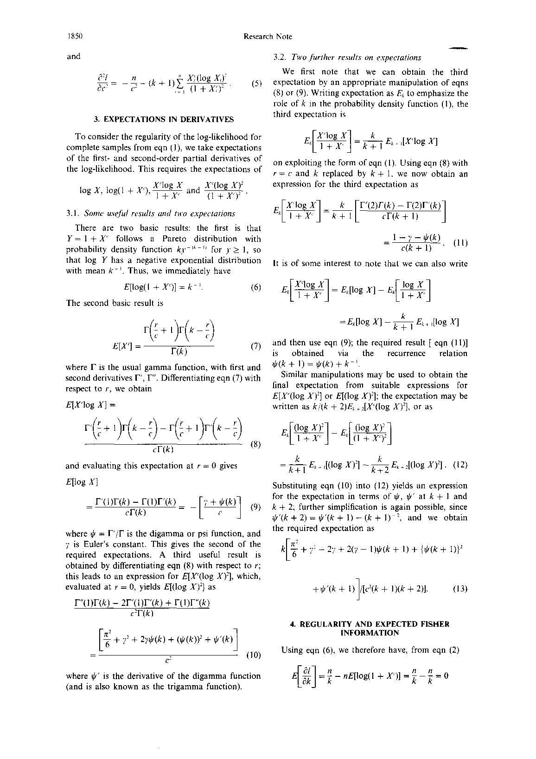
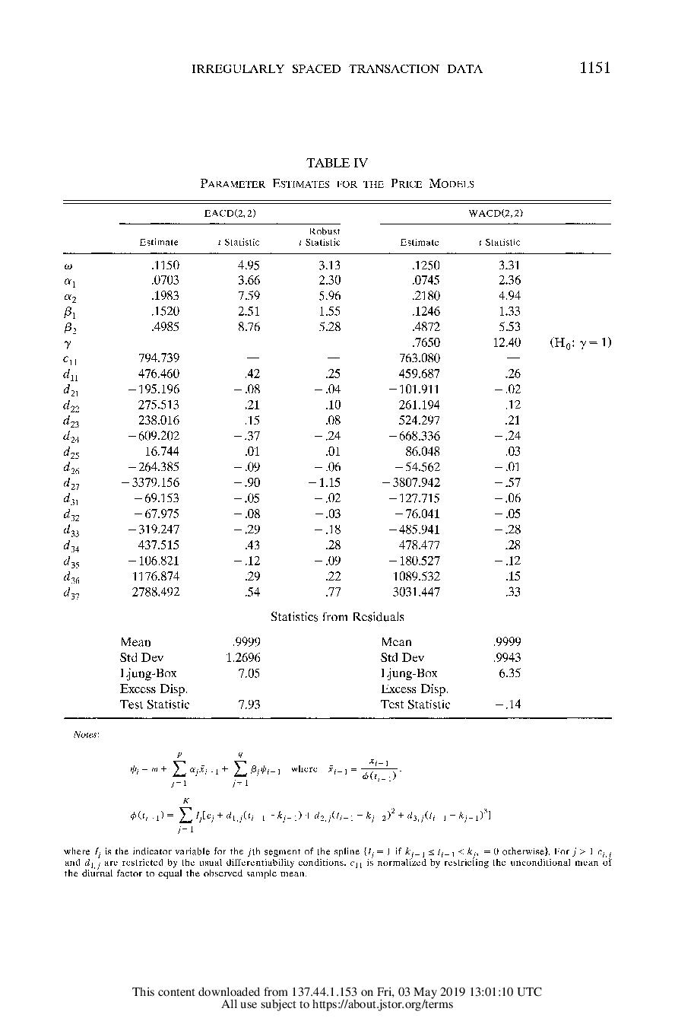

Slide 3
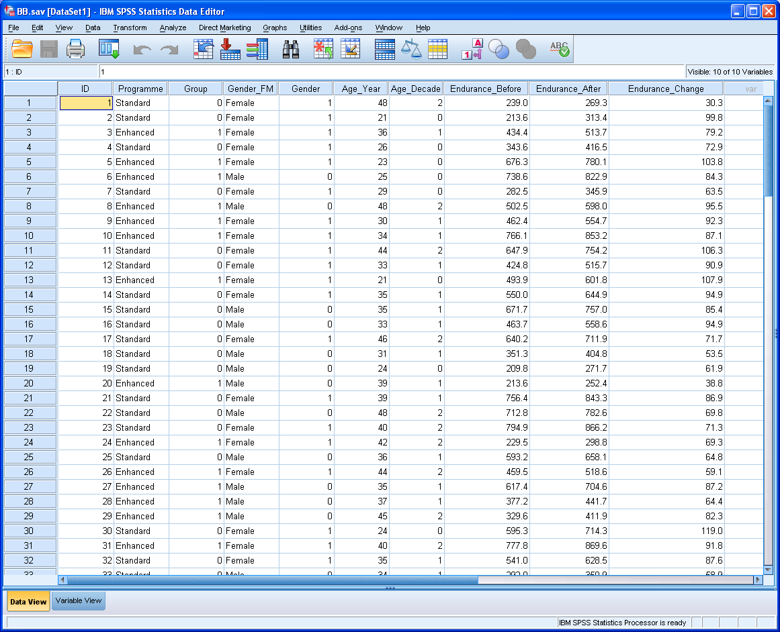

Data format

Slide 4
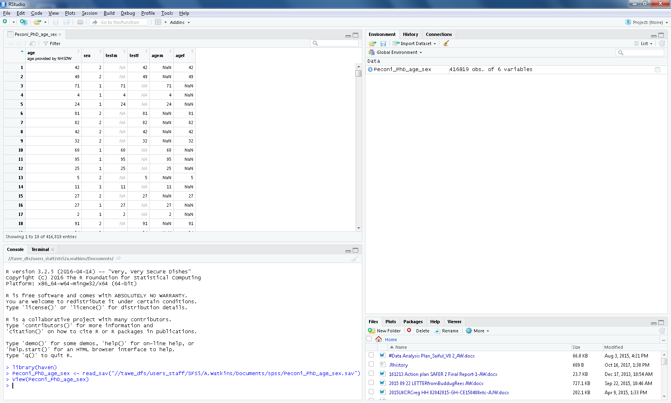

Slide 5
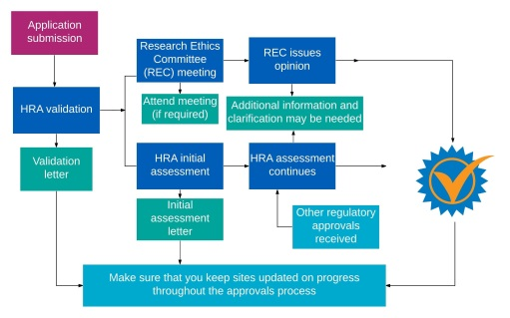



A changing health informatics landscape?
Evolving features
GDPR/REC, CAG & HRA/MHRA
NHS Digital/SAIL routine data/e-trials
Long-term follow-up as default
Enhanced PROMs input
Familiar landmarks
IT developments (REDCap cloud)
Funding (‘hard’ core/’soft’ external)
Data validation/oversight requirements
Consolidation/Collaboration
within Wales/UK/Internationally
Success requires solid foundations
Good ideas & creative/novel methods
Rigorous, well-defined studies
High-quality robust outputs with Impact

Slide 6
Three concepts (building blocks) CONSORT Statements Descriptive Statistics - summarise the data Inferential Statistics - analyse data & interpret the results Two guiding principles Repeatable analyses Understandable reporting (as per Lancet guidelines)

Slide 7

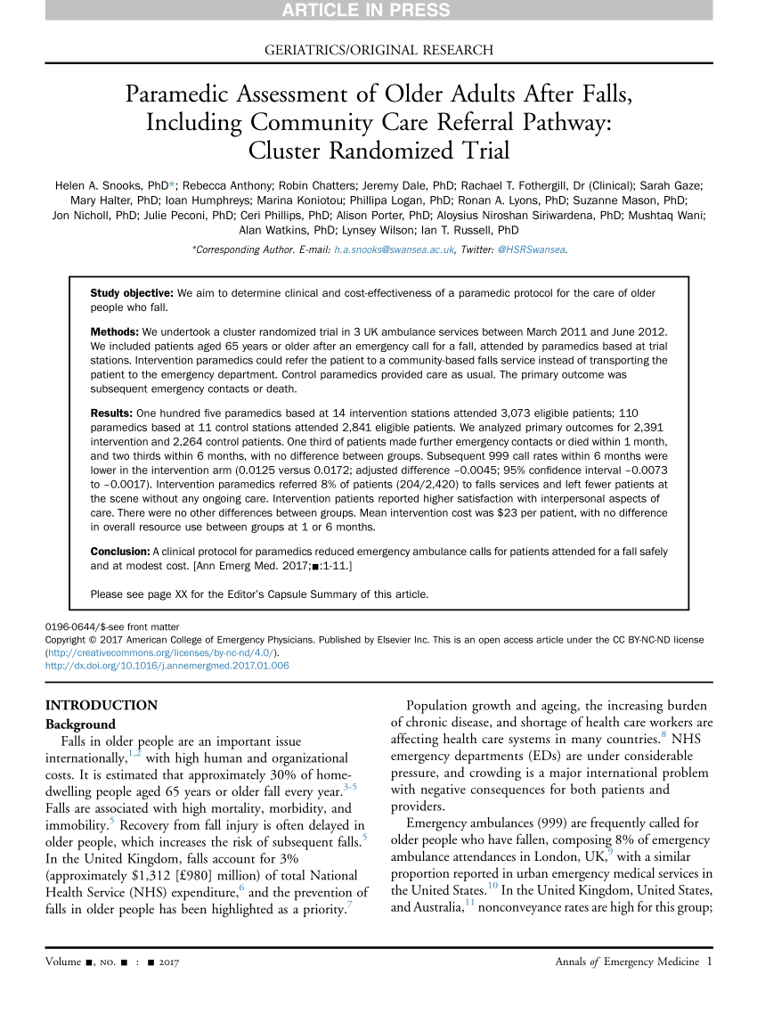

Slide 8
CTU Statistician: Role and responsibilities 1. To lead on development and execution of Statistical Analysis Plans, including sample size considerations and data specification, data validation and processing; summarising the analysis from CONSORT flow chart, demographic and baseline descriptions, and a full assessment (adjusted for case-mix) effect of the intervention under investigation. 2. To liaise on Health Economics to ensure consistency in analytical methods and reported findings 3. To respond to statistically-related comments from colleagues, reviewers and editors.

Slide 9
Statistical Methods: Outline
Do we even need statistics?
Can we collect useful (right?) data?
Where does the analysis fit?
Question ----------------→Answer
Question>Data ---------→Answer
Question>Data>Statistics>Answer
Data Management/Statistical Analysis Plans/Syntax or scripts

Slide 10
Key Statistical Principles …
Draw some pictures
choose appropriate graphical tools for data
Summarise the amount of data and the data itself
choose appropriate numerical measures
interpret these summaries correctly
Understand the basic concepts (& limitations) of statistical analysis
interpret (possibly, calculate) confidence intervals and p-values for key hypotheses
flow-charts can help, up to a point ….

Slide 11
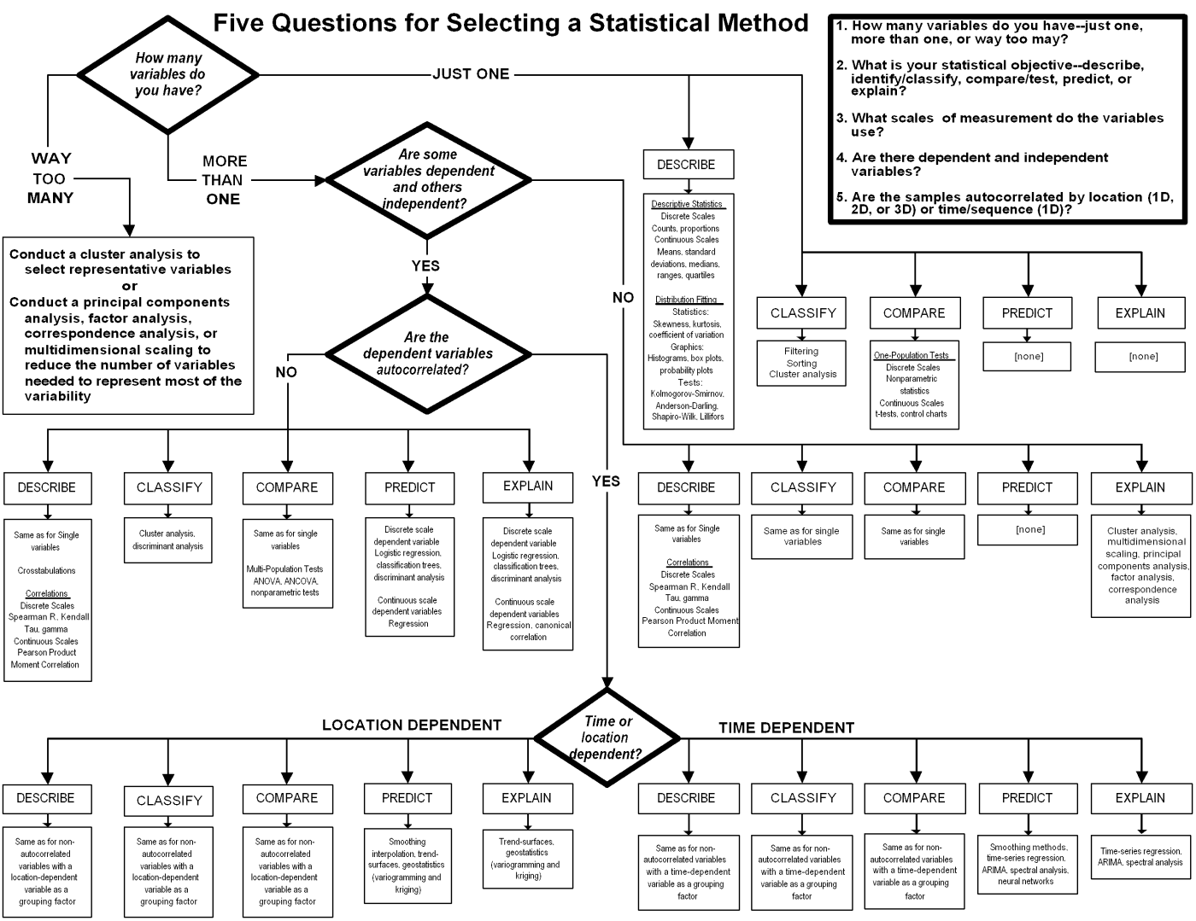

Slide 12
For discussion [1]
See three diagrams taken from published work.
Rate each of the three diagrams as Poor, Acceptable or Good
If Poor, could you suggest some necessary improvements?
If Good, could you summarise its message?
If Acceptable, could you summarise its message and suggest possible improvements?

Slide 13
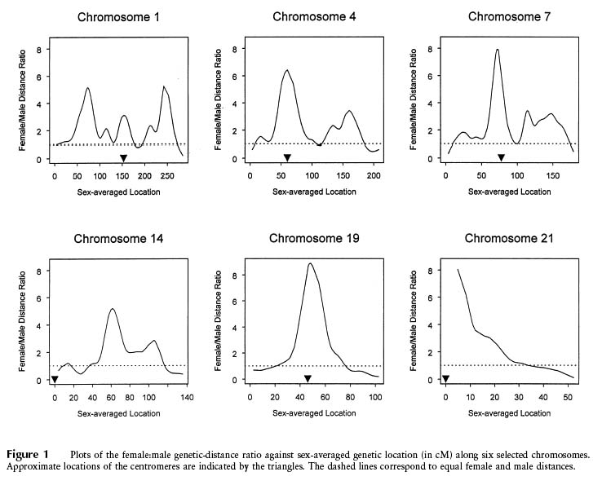
Broman et al American Journal of Human Genetics (1998) 63:861-869

Slide 14
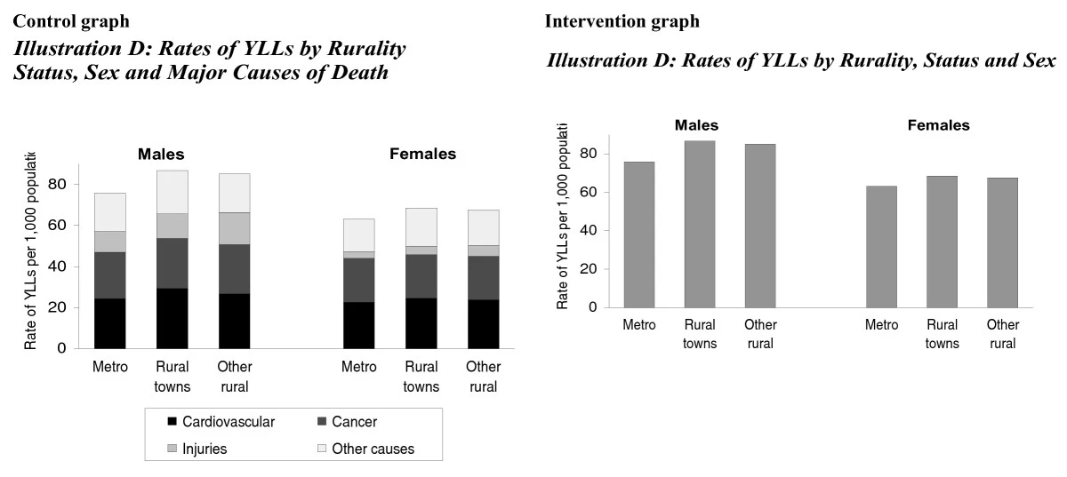
Muscatello et al BMC Medicine (2006) 4:33

Slide 15
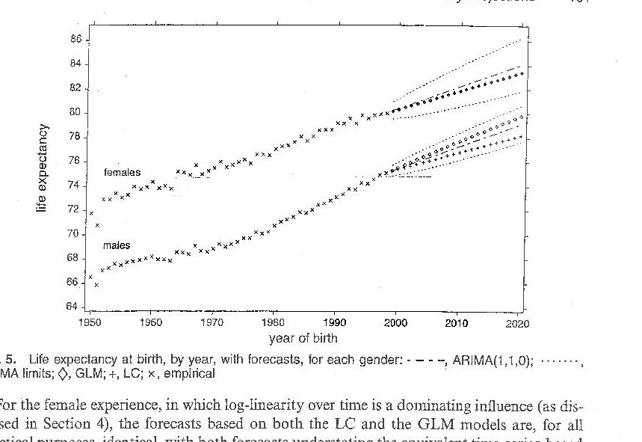

Slide 16
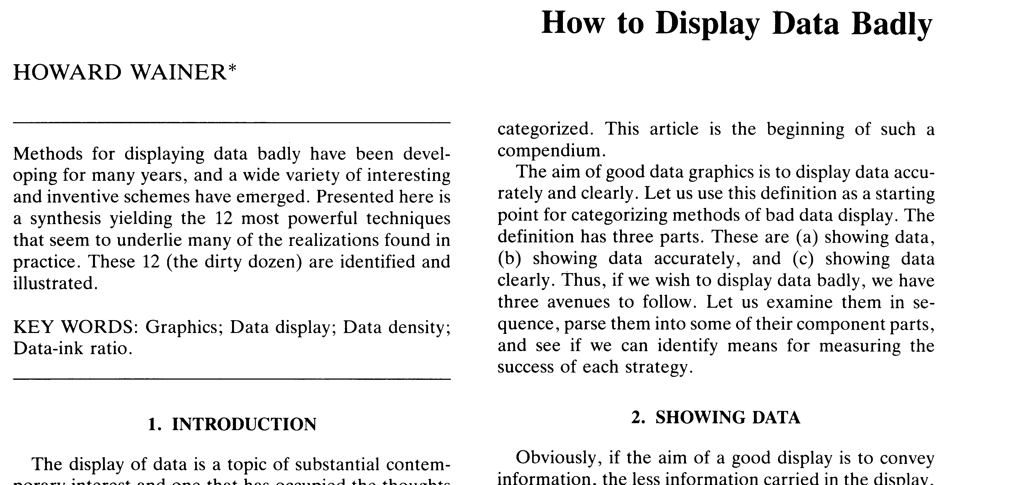
Wainer The American Statistician (1984) 38:2

Slide 17
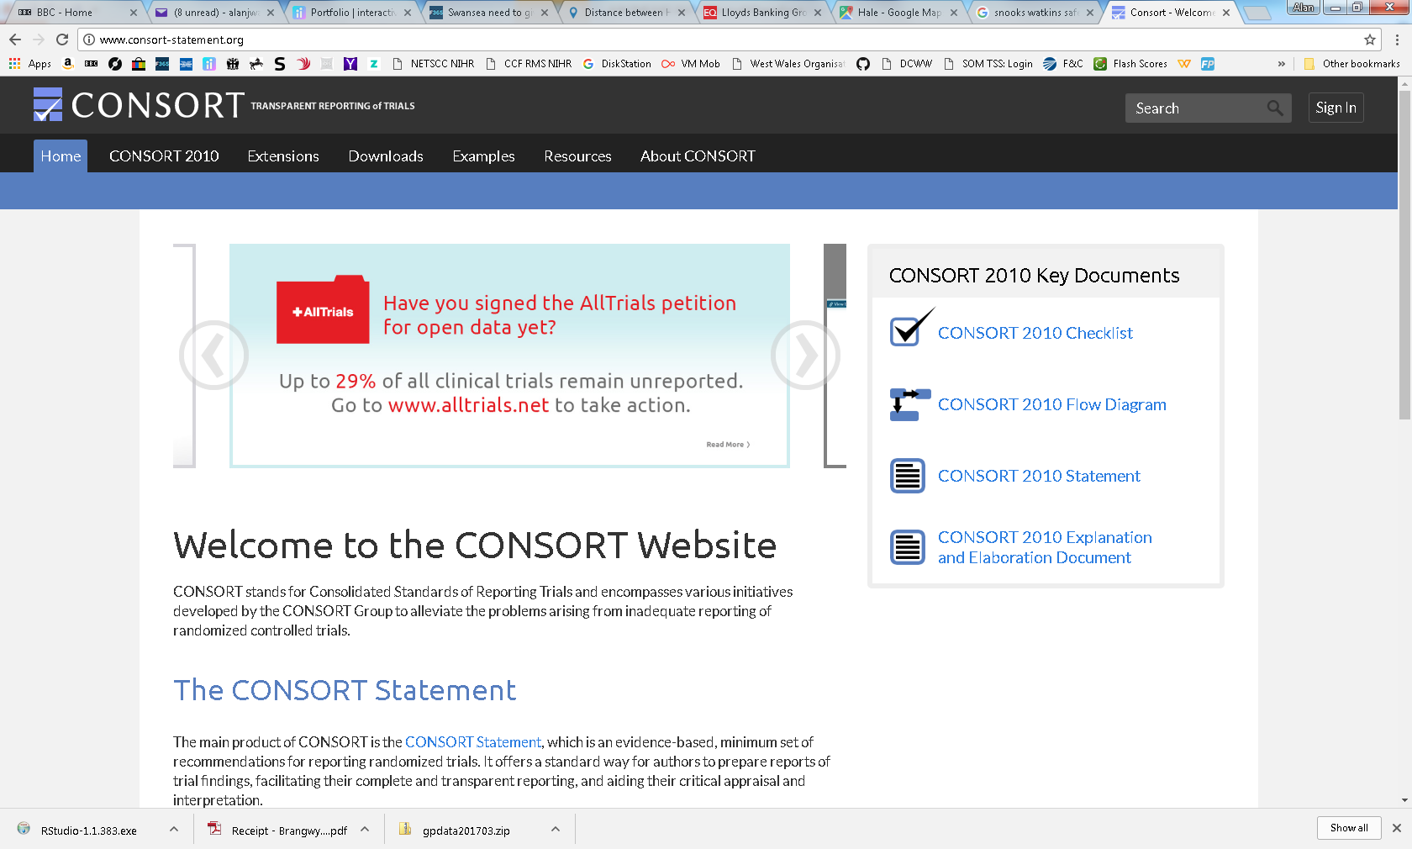
CONSORT Statements
Normal data – potential outliers
Different means
Possibly equal variances (this can be tested)
Estimating variance/s from data, so t-test

Slide 18
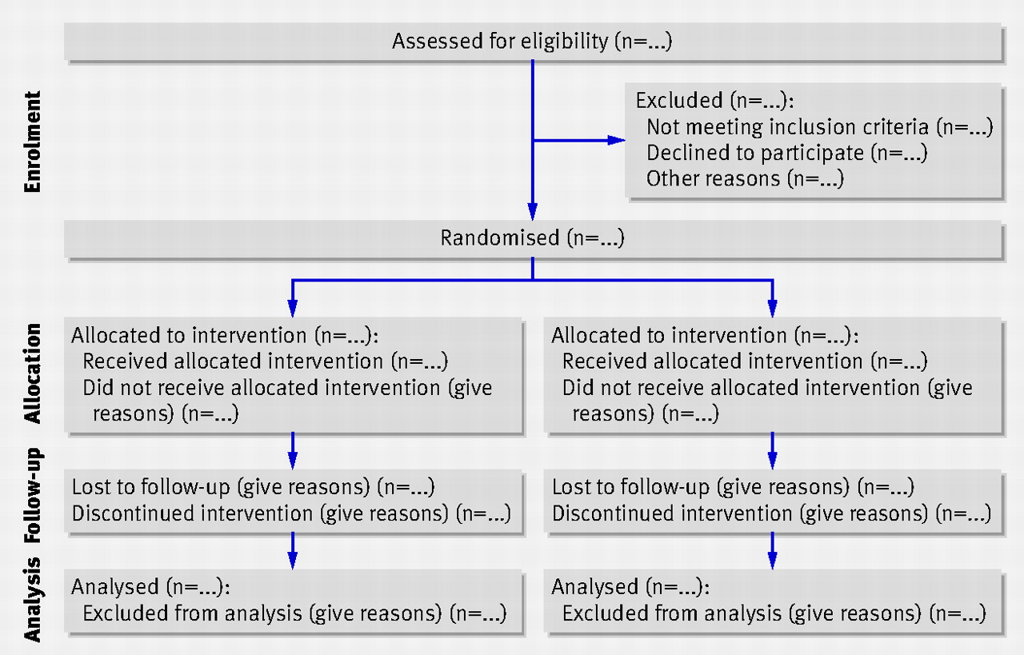

Slide 19
The CONSORT Industry: Checklists & extensions….
Reporting check-lists (25 items, sometimes more…);
For cluster trials;
For feasibility studies;
For abstracts;
For stepped wedge designs…
Required for submission to many journals (BMJ, Lancet, …)
See the airAware paper
Other checklists are available…

Slide 20
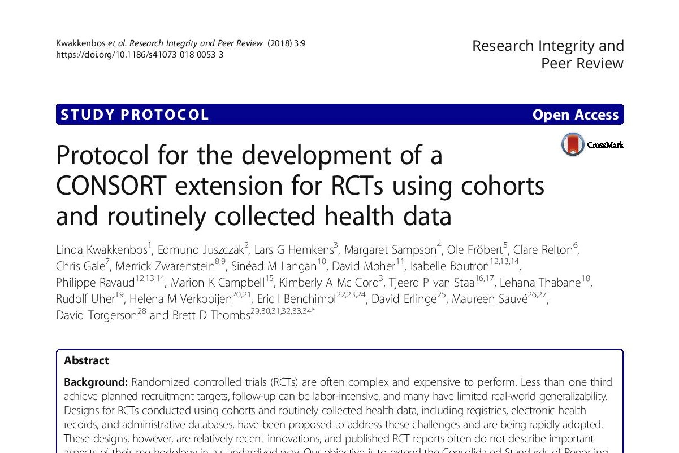

Slide 21
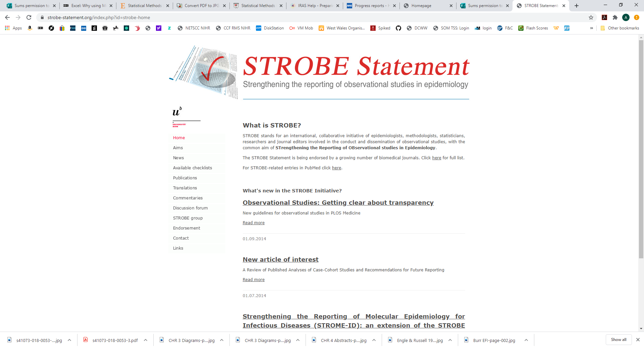

Slide 22
Data management & processing
Collate and code data
Compute new variables from old
BMI from height & weight
Patient Reported Outcome Measures (PROMS)
EQ5D, SF12 (general)
EORTC, CUCQ (condition specific)
Quality Adjusted Life Years (QALYs)
Indicators of events; time between events

Slide 23
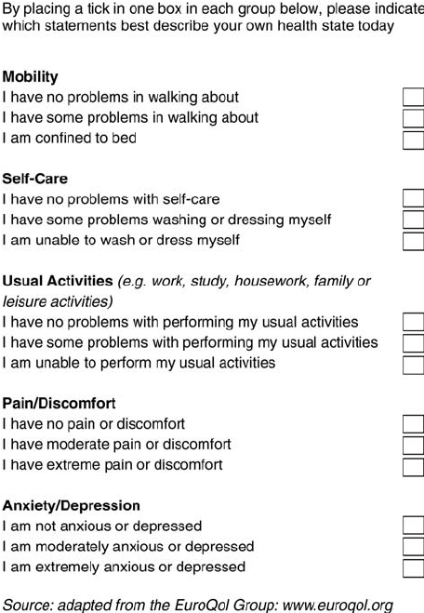
Quality of Life ~ EQ5D (3 level)
Score each question 1,2,3
Convert 5 scores into a single number
11111 1.0
22222 0.516
12321 0.329
21223 0.222
23322 0.079
33332 -0.429
(Dead = 0)

Slide 24
Data management & processing
Collect and prepare data with planned analysis in mind
Aim to produce “clean” & full rectangular data set to import into R, SPSS, Stata, SAS, MLWin,…
(but, ideally, NOT Excel! – why?)

Slide 25
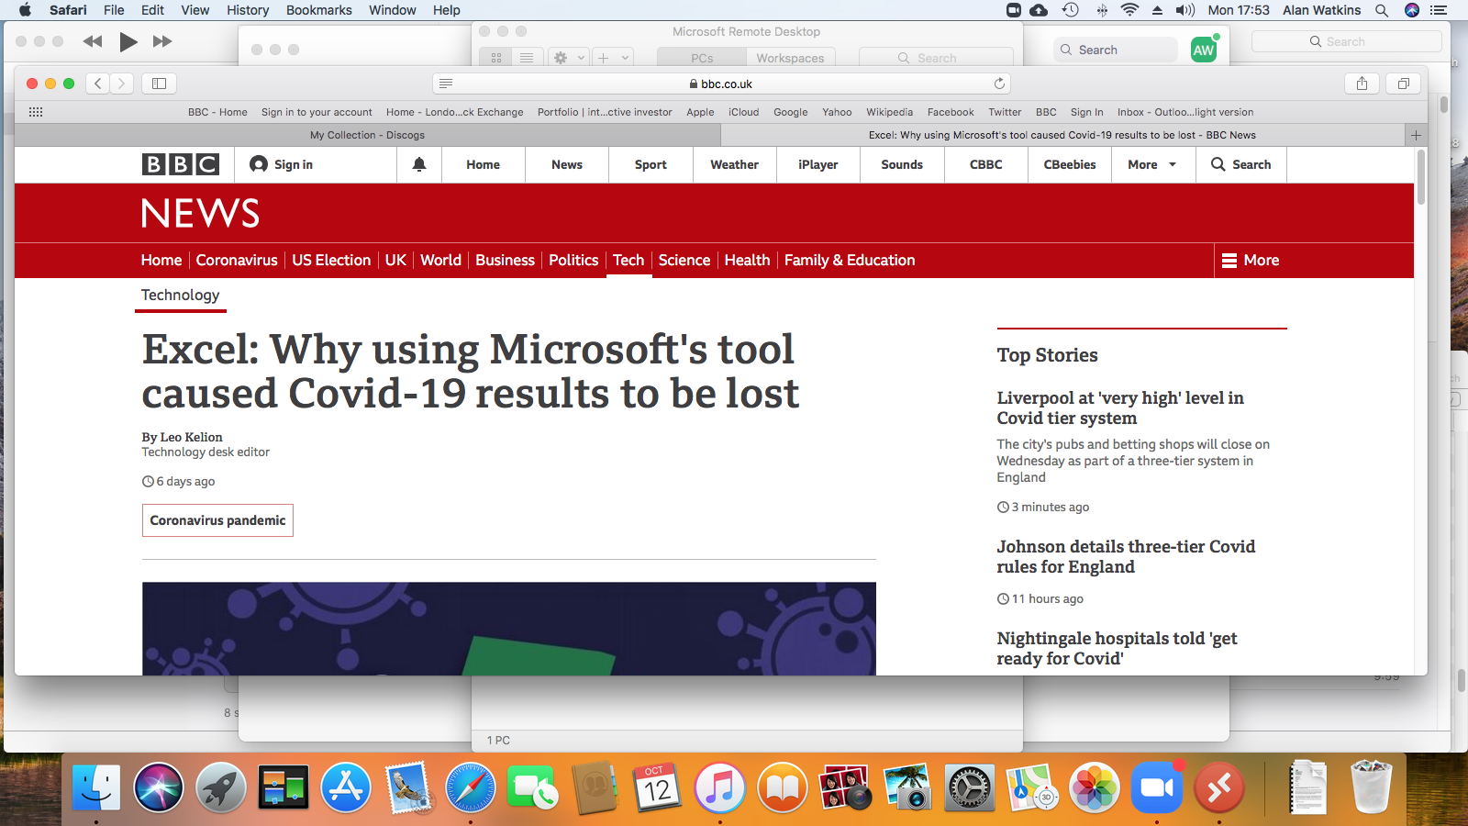

Slide 26
Data format

Slide 27
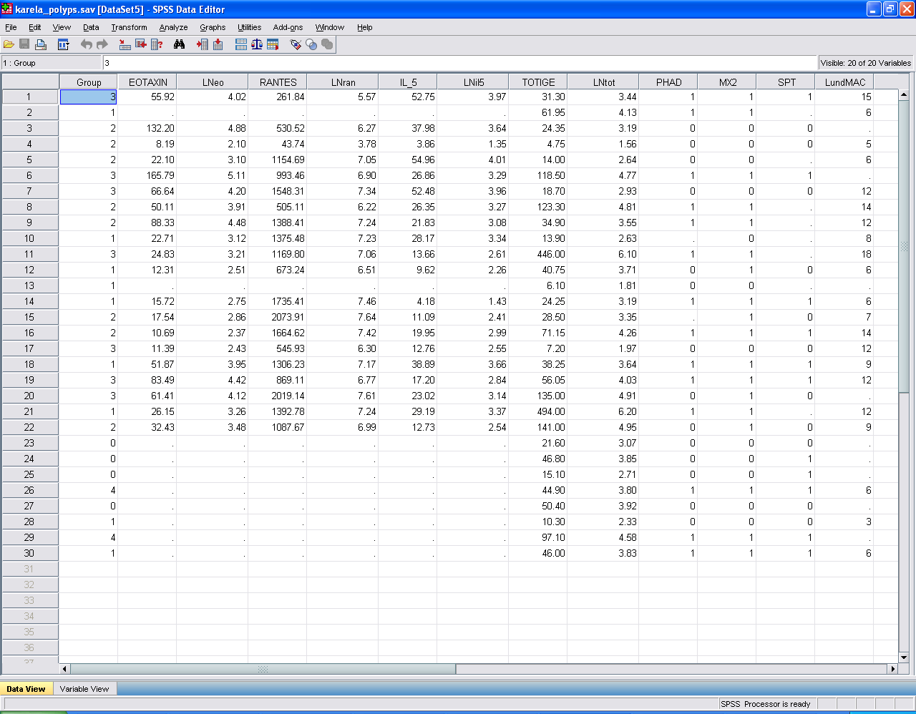

Slide 28
Data Types
Indicator/Nominal: different categories
Often binary
Absent/Present (coded as 0,1)
Male/Female
Control/Intervention
Red/Green/Blue (coded ?)
Ordinal: ordered categories:
Small/Medium/Large (coded ?)
Likert scales (5 or 7 or 9 points)
Very sure/Somewhat sure/Neither sure or unsure/Somewhat unsure/Very unsure
Measurement: discrete/count
Number of operations
Measurement: continuous/intervals
not necessarily a whole number
time between 999 call and ambulance arrival

Slide 29
Descriptive statistics & beyond …
Twin aims of statistics
Produce graphical and numerical summaries
Reflecting nature & quantity of data
Study and explain location and spread
Systematic variation versus randomness
Patterns -> Equations -> Models ->Effect size -> Predictions -> Cost Savings
Randomness: perhaps nothing more to be said, from the present data
Equations (“models”) reflect assumptions on data

Slide 30
Graphical Representations
Draw some pictures that go beyond basic bar and pie charts
Box Plots
Cumulative Frequency Plots
Histograms
Box (or Box & Whisker) Plots
shows spread & location
box from first to third quartile
line in the box to show median
whiskers from box to minimum and maximum values
extreme values marked as potential outliers

Slide 31
Box-plot: (data values: 16,31,34,24,42,19,36,26,50,35)

Slide 32

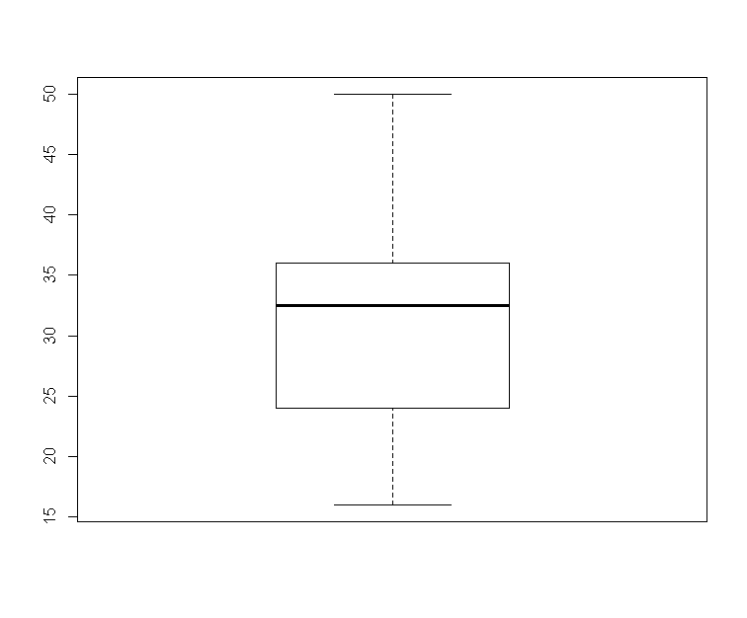
In R: d1<-c(16,31,34,24,42,19,36,26,50,35) boxplot(d1)

Slide 33
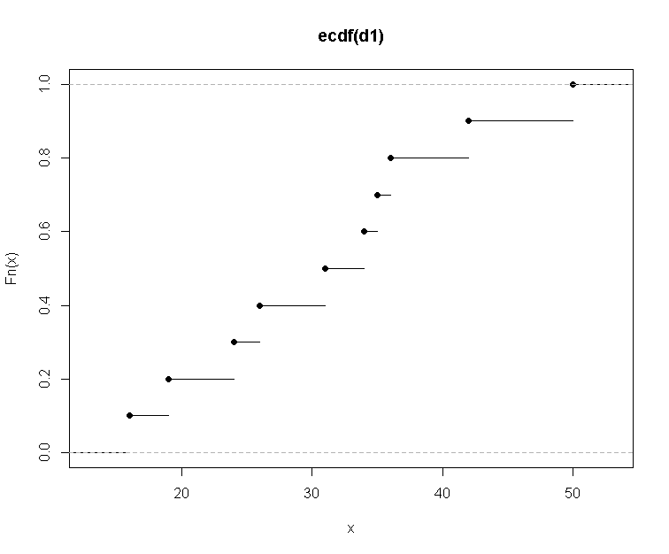
Cumulative distribution function plot(ecdf(d1))

Slide 34
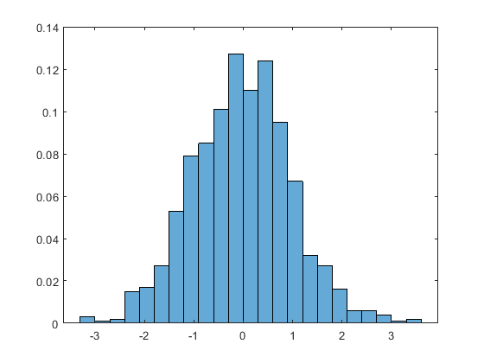

Slide 35
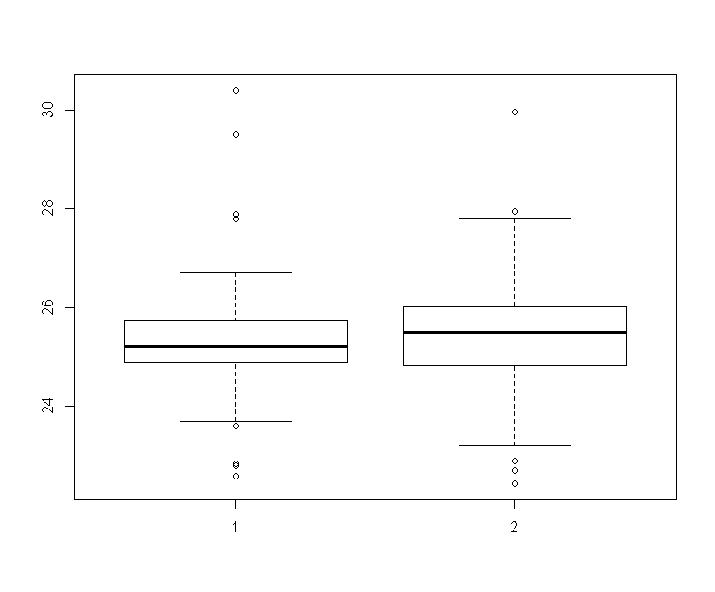
Compare two groups In R: boxplot(d2~group)

Slide 36
Numerical summaries
In R: d1<-c(16,31,34,24,42,19,36,26,50,35)
Then: mean(d1)
sd(d1) standard deviation (spread)
range(d1) minimum and maximum
min(d1) & max(d1) or separately
median(d1) middle value
quantile(d1,0.5) !note spelling!
quantile(d1,0.25) first quartile (middle of lower half)
quantile (d1,0.75) third quartile
quantile(d1,c(0.25, 0.5, 0.75))
summary(d1)
Gives Min/1st Quartile/Median/Mean/3rd Quartile/Max
16.00 24.50 32.50 31.30 35.75 50.00 (for d1,as above)

Slide 37
Descriptive & Inferential Methods
Description: summarise & illustrate data
Inference: to explain what we see or what can be shown in data
Analysis takes account of sampling variation
Analyse the sample that you have, while taking into account the samples you might have collected

Slide 38
Some Statistical Jargon
Populations, Normality, effect size
Null & alternative hypotheses
α (significance level) & β (power)
Type I & type II errors

Slide 39
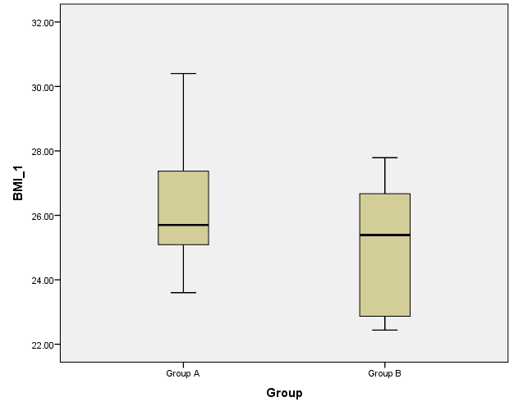
Focus on location and variation
Side by side box-plots of BMI
immediate comparison of two groups (A & B)

Slide 40
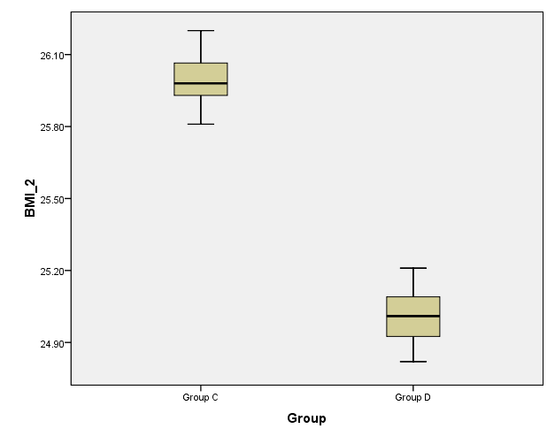
Different patterns of variation
Box-plots of BMI for two more groups C & D

Slide 41
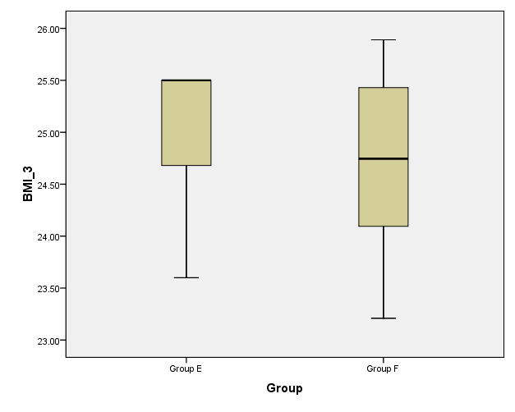
Variation & Its Many Forms
more BMI box-plots … (groups E & F)

Slide 42
For discussion [2]
Consider box-plots A & B
what (if any) tentative conclusions may be reached on similarities (or differences) between the two groups?
What about C & D? E & F?
Under what circumstances (or, in what trials) might we obtain a sample similar to C? E?

Slide 43
Univariate tests
Assess whether observed differences can be regarded as statistically significant taking within group variation into account.
Use t-tests to compare means of measurement variables;
Use chi-squared to compare proportions of binary outcomes.
Assumptions (such as Normality) now appear
Alternative methods make different assumptions
Only context (Group membership) to explain why such differences may have arisen
For instance, A=control, B=intervention.

Slide 44
Confidence intervals & p-values
Confidence interval (usually 95%)
A guide to plausible values of the true (unknown) population difference centered on the observed (sample) difference
Focus on whether this interval includes 0 or not
p-value
Assuming the true difference is 0, the probability of observing a difference greater than that actually observed
Focus on whether this is less than 0.05 or not
Relation
The 95% CI includes 0 is equivalent to p > 0.05
The 95% CI excludes 0 is equivalent to p < 0.05

Slide 45
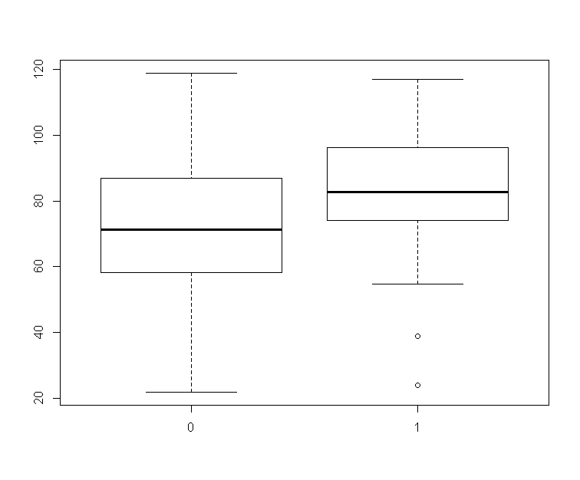
Two sample t-test
boxplot(change~group) to produce side by side box-plots
gives immediate comparison of two groups

Slide 46
In R: t.test(change~group)
Welch Two Sample t-test data:
change by group
t = -3.7411, df = 123.15, p-value = 0.0002796
alternative hypothesis:
true difference in means is not equal to 0
95 percent confidence interval:
-19.579558 -6.029615
sample estimates:
mean in group 0 mean in group 1
71.30981 84.11440

Slide 47
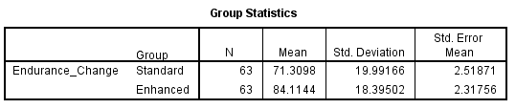
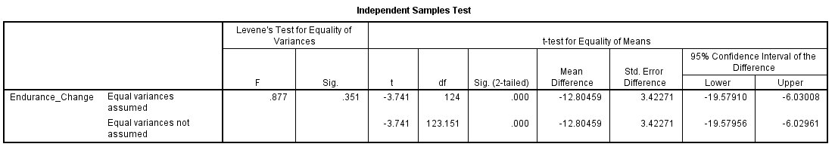
Corresponding SPSS Output

Slide 48
Results and Interpretation
Summary statistics
t-test statistic, df (degrees of freedom) and corresponding p-value
Confidence interval for difference in means
The observed difference is statistically significant

Slide 49
Equivalent forms of analysis
Statistical methods mean we can obtain essentially the same analysis in various ways:
Two sample t-test
Linear Model
Regression
Some approaches lead more naturally to useful generalisations.

Slide 50
Categorical Data
Data comprises two observed categorical responses
Example: gender, and survival (an event during follow-up or not)
Variable 1: gender: male or female
Variable 2: survival: event during follow-up period or not
Data female male
Event in follow-up 28 48
Event-free 72 102
In R: table(event, gender)

Slide 51
Chi-squared analysis of Cross-tabulations
In R: chisq.test(table(event,gender),correct=FALSE)
Pearson's Chi-squared test
data: table(event, gender)
X-squared = 0.45372, df = 1, p-value = 0.5006
Compare this with output from chisq.test(table(event,gender),correct=TRUE)
Slightly different assumptions -> different answers

Slide 52
Remember that …
Statistics generally appear both at the start (design) and end (analyis) of a trial.
Good statistical analysis can’t completely overcome limitations of bad design
For instance, sample size too small
Poor statistical analysis can almost ruin an otherwise well-designed trial.

Slide 53
For discussion [3]
See four extracts taken from published work.
Can you determine trial aim, sample size, study design?
Primary outcome? Secondary outcomes?
Detail of analysis undertaken? Findings?
Is the data available?
Given the data, could one repeat the reported analyses?

Slide 54
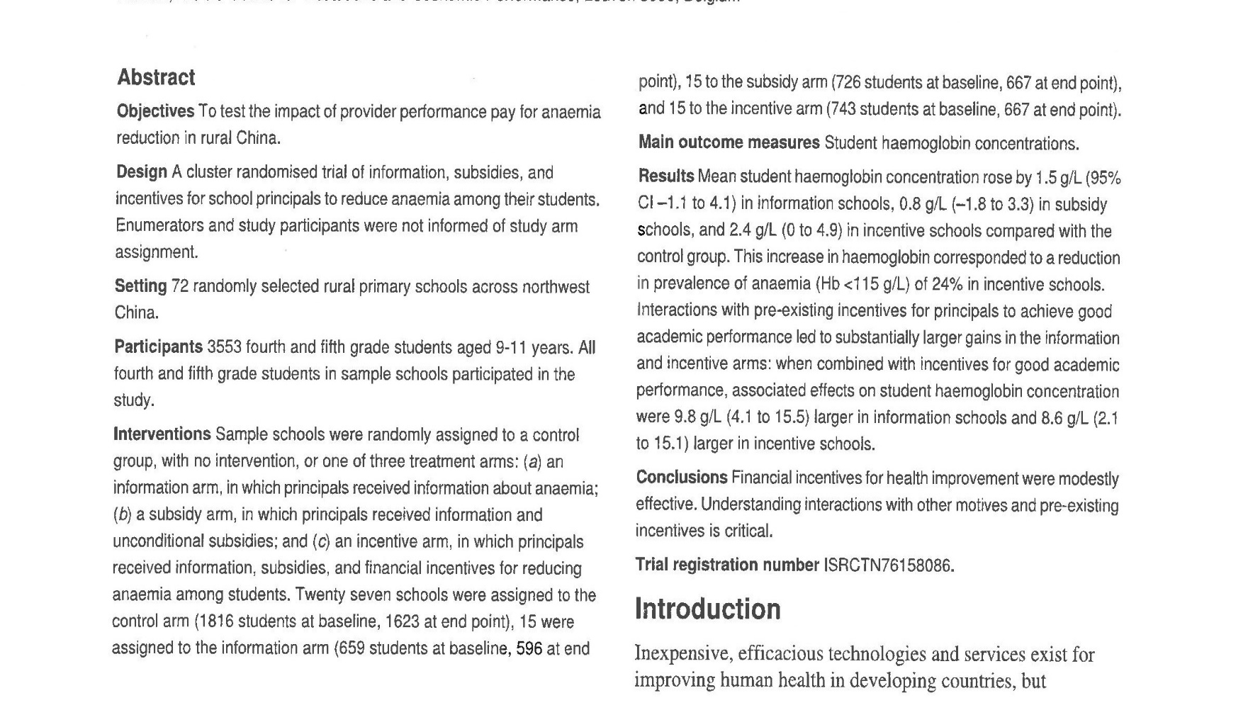
Miller et al: BMJ 2012

Slide 55
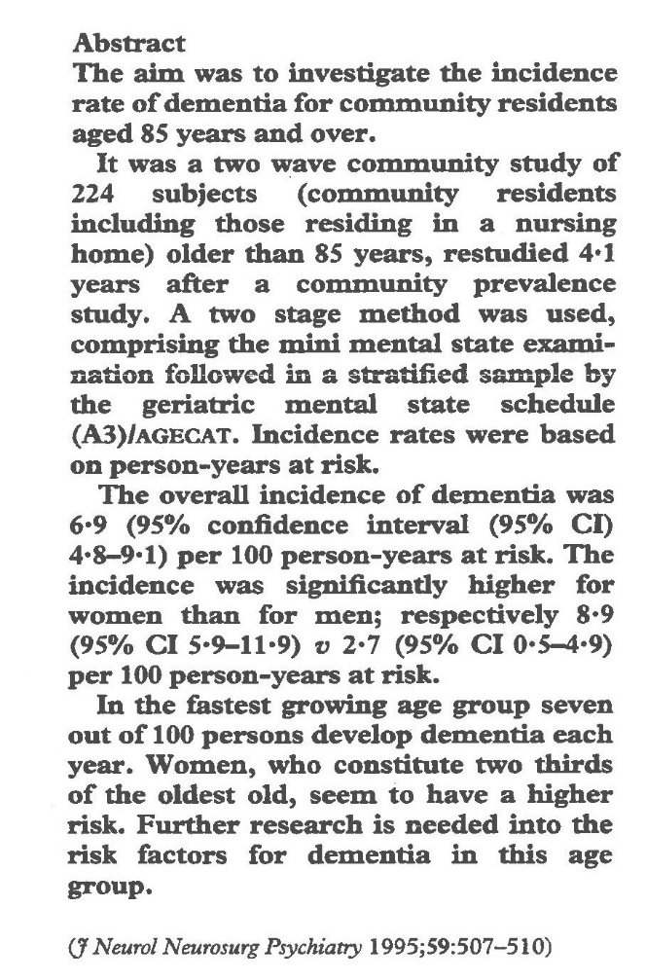
Gussekloo et al

Slide 56
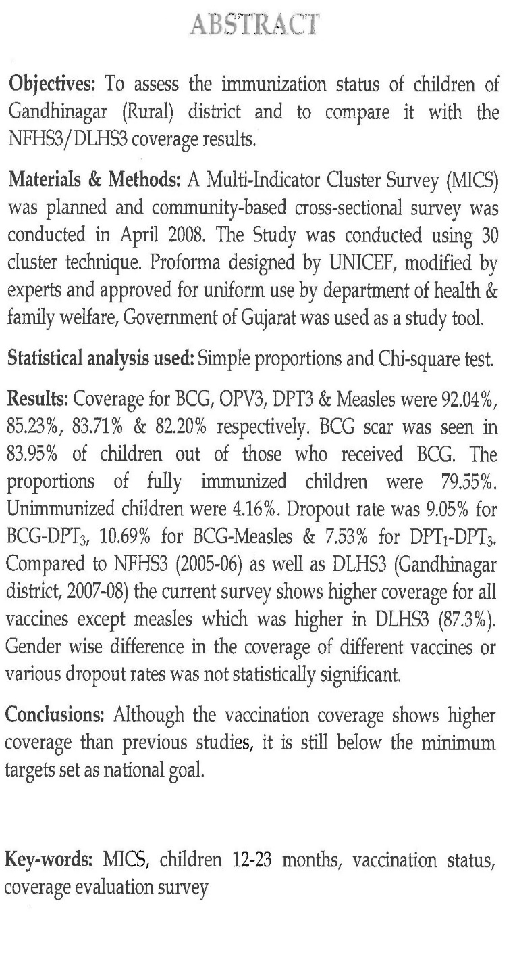
Sheth et al (2012)

Slide 57
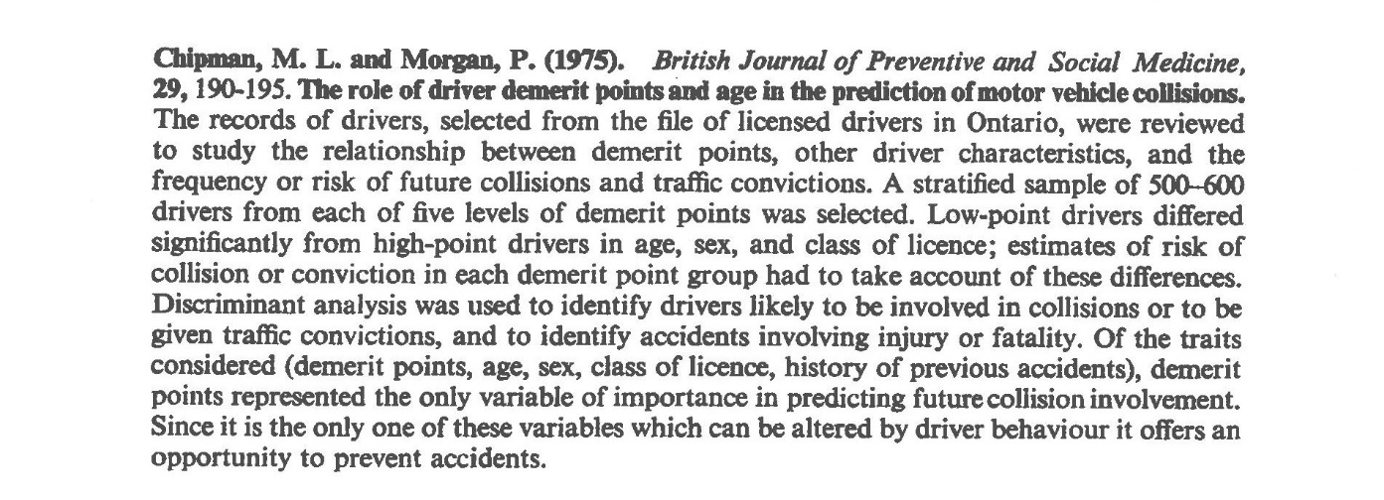

Slide 58
Further Reading ...
www.consort-statement.org
An Introduction To Medical Statistics
Martin Bland, OUP.
Practical Statistics For Medical Research
D.G. Altman, Chapman & Hall.
Alan Watkins a.watkins@swansea.ac.uk

Slide 59


